Slide 1
Multiplexer / Demultiplexer
Notes:
Multiplexers & Demultiplexers
Digital Electronics™
Lesson 2.4 – Specific Combo Circuits & Misc Topics
Project Lead The Way, Inc.
Copyright 2009

Slide 2
Multiplexer / Demultiplexer
This presentation will demonstrate
The basic function of the Multiplexer (MUX).
The typical application of a MUX.
A 4-to-1 MUX designed with Small Scale Integration (SSI).
A 4-to-1, 8-to-1, & 16-to-1 Medium Scale Integration (MSI) MUX.
The basic function of the Demultiplexer (DEMUX).
The typical application of a DEMUX.
A 1-to-4 DEMUX design with Small Scale Integration (SSI).
A 1-to-4, 1-to-8, & 1-to-16 Medium Scale Integration (MSI) DEMUX.
A 7-segment message display using MUX/DEMUX.
Notes:
Introductory Slide / Overview of Presentation
Multiplexers & Demultiplexers
Digital Electronics™
Lesson 2.4 – Specific Combo Circuits & Misc Topics
Project Lead The Way, Inc.
Copyright 2009

Slide 3
What is a Multiplexer (MUX)?
A MUX is a digital switch that has multiple inputs (sources) and a single output (destination).
The select lines determine which input is connected to the output.
MUX Types
  → 2-to-1 (1 select line)
  → 4-to-1 (2 select lines)
  → 8-to-1 (3 select lines)
  → 16-to-1 (4 select lines)
Multiplexer
Block Diagram
2^{N}
1
Inputs
(sources)
MUX
Output
(destination)
N
Select
Lines
Notes:
Multiplexers & Demultiplexers
Digital Electronics™
Lesson 2.4 – Specific Combo Circuits & Misc Topics
Project Lead The Way, Inc.
Copyright 2009

Slide 4




Typical Application of a MUX
Multiple Sources
Selector
Single Destination
MP3 Player
Docking Station
D0
D1
D2
D3
Laptop
Sound Card
MUX
Y
Surround Sound System
Digital
Satellite
B | A | Selected Source
0 | 0 | MP3
0 | 1 | Laptop
1 | 0 | Satellite
1 | 1 | Cable TV
Digital
Cable TV
Notes:
This slide shows a typical application of a multiplexer (in this case a 4-to-1 MUX). Have the students share other common applications of MUXs.
http://images.tigerdirect.ca/skuimages/large/Logitech-X-540-L23-7250-mai.jpg
Multiplexers & Demultiplexers
Digital Electronics™
Lesson 2.4 – Specific Combo Circuits & Misc Topics
Project Lead The Way, Inc.
Copyright 2009

Slide 5
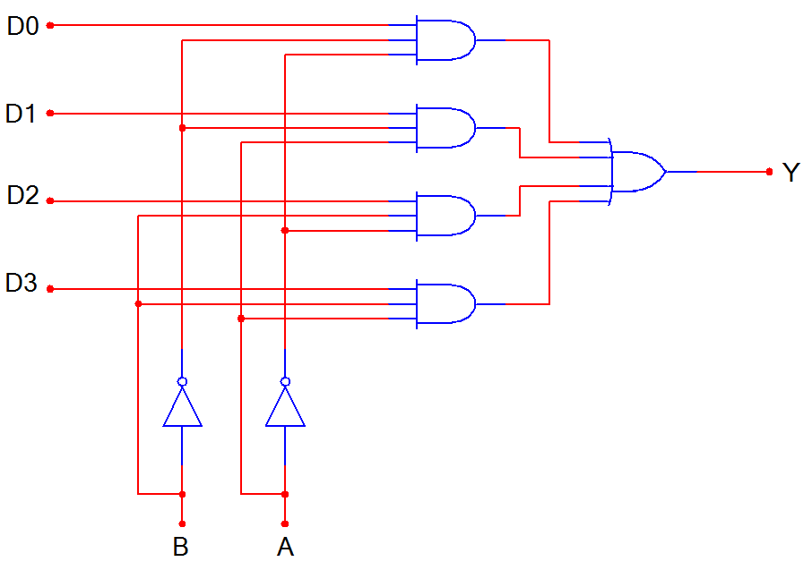
4-to-1 Multiplexer (MUX)
D0
D1
D2
D3
MUX
Y
B A
B | A | Y
0 | 0 | D0
0 | 1 | D1
1 | 0 | D2
1 | 1 | D3
Notes:
SSI logic diagram, block diagram, and truth table for a 4-to-1 MUX
Multiplexers & Demultiplexers
Digital Electronics™
Lesson 2.4 – Specific Combo Circuits & Misc Topics
Project Lead The Way, Inc.
Copyright 2009

Slide 6
4-to-1 Multiplexer Waveforms
D0
D1
D2
D3
A
B
Y
 | D0 | D1 | D2 | D3 | D0 | D1 | D2 | D3
Input
Data
Select
Line
Output
Data
Notes:
Waveform diagram for a 4-to-1 MUX. The input data signals (D0-D3) are colored RED to indicate when its is connected to the output Y. Note: There is no significance to the values of the four input data signals; they are intended solely to demonstrate that the select lines (A & B) will select what input data signal will be connected to the output.
Multiplexers & Demultiplexers
Digital Electronics™
Lesson 2.4 – Specific Combo Circuits & Misc Topics
Project Lead The Way, Inc.
Copyright 2009

Slide 7
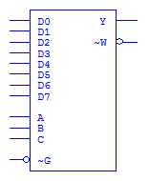
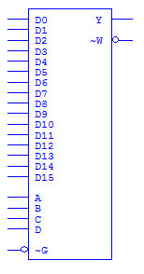
Medium Scale Integration MUX
4-to-1 MUX
8-to-1 MUX
16-to-1 MUX
Inputs
Output (Y)
(and inverted output)
Select
Enable
Notes:
Block diagrams for 4-to-1, 8-to-1, and 16-to-1 MSI Multiplexers.
Multiplexers & Demultiplexers
Digital Electronics™
Lesson 2.4 – Specific Combo Circuits & Misc Topics
Project Lead The Way, Inc.
Copyright 2009

Slide 8
What is a Demultiplexer (DEMUX)?
A DEMUX is a digital switch with a single input (source) and a multiple outputs (destinations).
The select lines determine which output the input is connected to.
DEMUX Types
  → 1-to-2 (1 select line)
  → 1-to-4 (2 select lines)
  → 1-to-8 (3 select lines)
  → 1-to-16 (4 select lines)
Demultiplexer
Block Diagram
1
2^{N}
Input
(source)
DEMUX
Outputs
(destinations)
N
Select
Lines
Notes:
This slide explains the function of a demultiplexer.
Multiplexers & Demultiplexers
Digital Electronics™
Lesson 2.4 – Specific Combo Circuits & Misc Topics
Project Lead The Way, Inc.
Copyright 2009

Slide 9
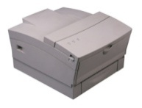
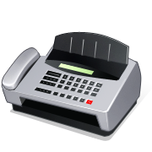



Typical Application of a DEMUX
Single Source
Selector
Multiple Destinations
B/W Laser
Printer
Fax
Machine
D0
D1
D2
D3
X
DEMUX
Color Inkjet
Printer
B | A | Selected Destination
0 | 0 | B/W Laser Printer
0 | 1 | Fax Machine
1 | 0 | Color Inkjet Printer
1 | 1 | Pen Plotter
Pen
Plotter
Notes:
This slide shows a typical application of a demultiplexer (in this case a 1-to-4 DEMUX). Ask students to share other common applications of DEMUXs.
Multiplexers & Demultiplexers
Digital Electronics™
Lesson 2.4 – Specific Combo Circuits & Misc Topics
Project Lead The Way, Inc.
Copyright 2009

Slide 10
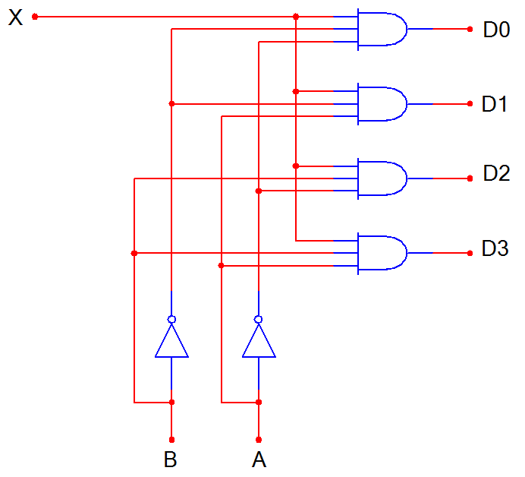
1-to-4 De-Multiplexer (DEMUX)
D0
D1
D2
D3
X
DEMUX
B A
B | A | D0 | D1 | D2 | D3
0 | 0 | X | 0 | 0 | 0
0 | 1 | 0 | X | 0 | 0
1 | 0 | 0 | 0 | X | 0
1 | 1 | 0 | 0 | 0 | X
Notes:
SSI logic diagram, block diagram, and truth table for a 1-to-4 De-MUX
Multiplexers & Demultiplexers
Digital Electronics™
Lesson 2.4 – Specific Combo Circuits & Misc Topics
Project Lead The Way, Inc.
Copyright 2009

Slide 11
1-to-4 De-Multiplexer Waveforms
X
S0
S1
D0
D1
D2
D3
Input
Data
Select
Line
Output
Data
Notes:
Waveform diagrams for a 1-to-4 De-MUX. The output signals (D0-D3) are colored RED to indicate when its is connected to the input X. Note: There is no significance to the value of the input data signal; it is intended solely to demonstrate that the select lines (A & B) will determine what output signal is connected to the input.
Multiplexers & Demultiplexers
Digital Electronics™
Lesson 2.4 – Specific Combo Circuits & Misc Topics
Project Lead The Way, Inc.
Copyright 2009

Slide 12
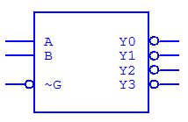
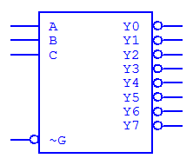
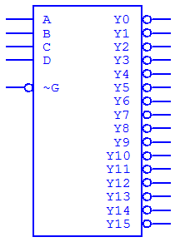
Medium Scale Integration DEMUX
1-to-4 DEMUX
1-to-8 DEMUX
16-to-1 MUX
Select
Outputs
(inverted)
Input
(inverted)
Note : Most Medium Scale Integrated (MSI) DEMUXs , like the three shown, have outputs that are inverted. This is done because it requires few logic gates to implement DEMUXs with inverted outputs rather than no-inverted outputs.
Notes:
Block diagrams for 1-to-4, 1-to-8, and 1-to-16 MSI Demultiplexers.
Multiplexers & Demultiplexers
Digital Electronics™
Lesson 2.4 – Specific Combo Circuits & Misc Topics
Project Lead The Way, Inc.
Copyright 2009

Slide 13


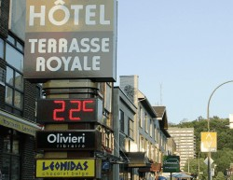

Seeing Is NOT Always Believing
Our lives are filled with electronic signs that display the time, temperature, or ball game score. However, what we see is not always what is really happening.
In fact for most displays, the individual display segments are cycled through so that only one display is on at any given time.
The cycle speed is so fast that the human eye perceives that all segments are on.
brgprecision.com
electronic-scoreboard.com
digicam-tech.com
nu-mediadisplays.com/signs/time-displays.php
Notes:
This slide provides examples of various electronics signs and explains that display segments are not all on simultaneously.
www.brgprecision.com
www.digicam-tech.com
www.electronic-scoreboard.com
http://www.nu-mediadisplays.com/signs/time-displays.php
Multiplexers & Demultiplexers
Digital Electronics™
Lesson 2.4 – Specific Combo Circuits & Misc Topics
Project Lead The Way, Inc.
Copyright 2009

Slide 14
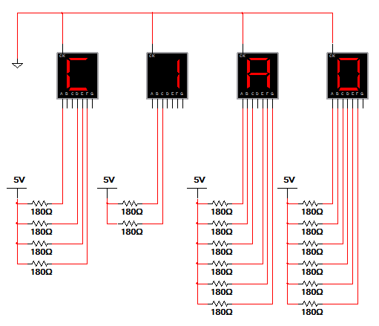
Simple Message: All Segments On
The circuit to the right uses four 7-segment displays to display the word CIAO. In this circuit all displays are continuously illuminated, each displaying one letter in the word.
Though this method works, it is a VERY inefficient use of power. To illuminate the simple message CIAO in this way, 18 segments must be continuously on.
Can you think of another way to display this message that would use less power?
Notes:
This slide shows how a simple message can be displayed using seven-segments displays. The drawback to this method is that all displays are on simultaneously. To display CIAO, 18 segments must be on, all drawing current and using power. Ask students to consider ways that they could display the message WITHOUT running all displays simultaneously.
Multiplexers & Demultiplexers
Digital Electronics™
Lesson 2.4 – Specific Combo Circuits & Misc Topics
Project Lead The Way, Inc.
Copyright 2009

Slide 15
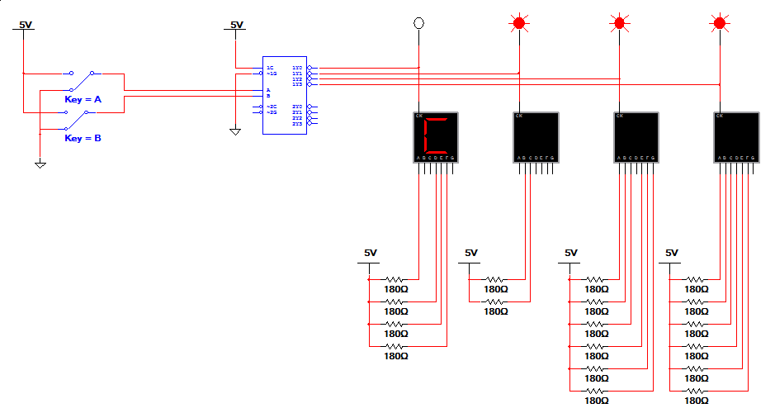
Multiplexed Displays Segments
Manual Selector
Demultiplexer
Multiplexed Displays
In this circuit the display segments are multiplexed, meaning that only one display is on at a time.
To display the entire word, the displays must be de-multiplexed using a 1-to-4 DEMUX.
In this example the select lines that control the DEMUX are connected to two switches. You must toggle 00, 01, 10, 11 to see the entire message.
(Not Practical)
Notes:
This slide shows how to de-multiplex four multiplexed seven segment displays. The advantage of this method is that only one display is on at any time. To display CIAO, at most 6 segments will be on at any time (for letters A & O).
Multiplexers & Demultiplexers
Digital Electronics™
Lesson 2.4 – Specific Combo Circuits & Misc Topics
Project Lead The Way, Inc.
Copyright 2009

Slide 16
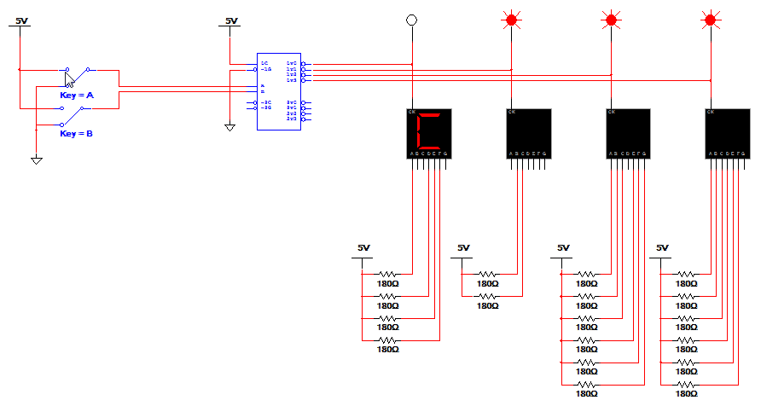
Let’s See How It Works
Click Schematic to Play Video
Notes:
Click the schematic to play the video of the de-multiplexing of the multiplexed displays.
Multiplexers & Demultiplexers
Digital Electronics™
Lesson 2.4 – Specific Combo Circuits & Misc Topics
Project Lead The Way, Inc.
Copyright 2009

Slide 17
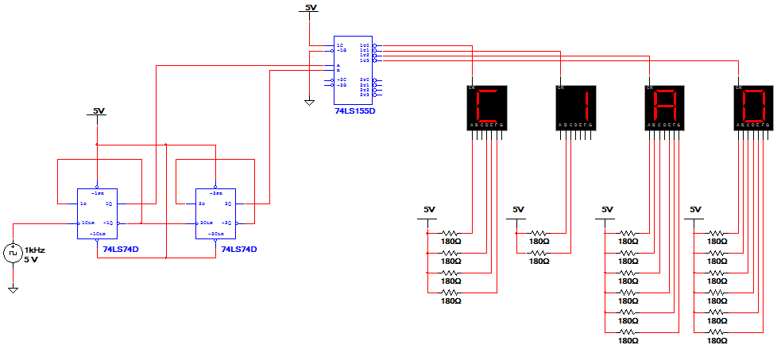
Complete Design
This is a ripple counter (remember the dice game).
We will learn how to design a ripple counter in unit 3.
Notes:
This schematic illustrates the complete design. In this circuit a 2-bit ripple counter has replaced the manual switches. Note: This design does work, but if you try to simulate it, the displays will not look correct. This has nothing to do with the design, but is caused by the inability of the simulator to keep up with the clock.
Multiplexers & Demultiplexers
Digital Electronics™
Lesson 2.4 – Specific Combo Circuits & Misc Topics
Project Lead The Way, Inc.
Copyright 2009

